Slide 1


Supermarket Conceptual Model
Agent Based Modeling
Aman Niyaz 20135262
Divya Gangamagala 20002971
Lei Hao 19167024
Yukti Patil 20097786

Slide 2

Supermarket Checkout Queue
Agents
Checkout
Manager
Scanner
Customer
Time
Weather
Agents under consideration
Products
Pandemic

Slide 3
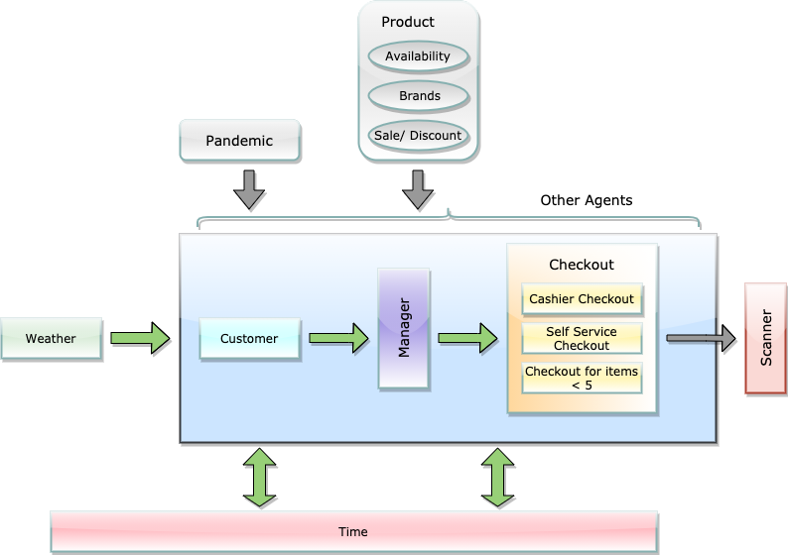
Conceptual Model

Slide 4
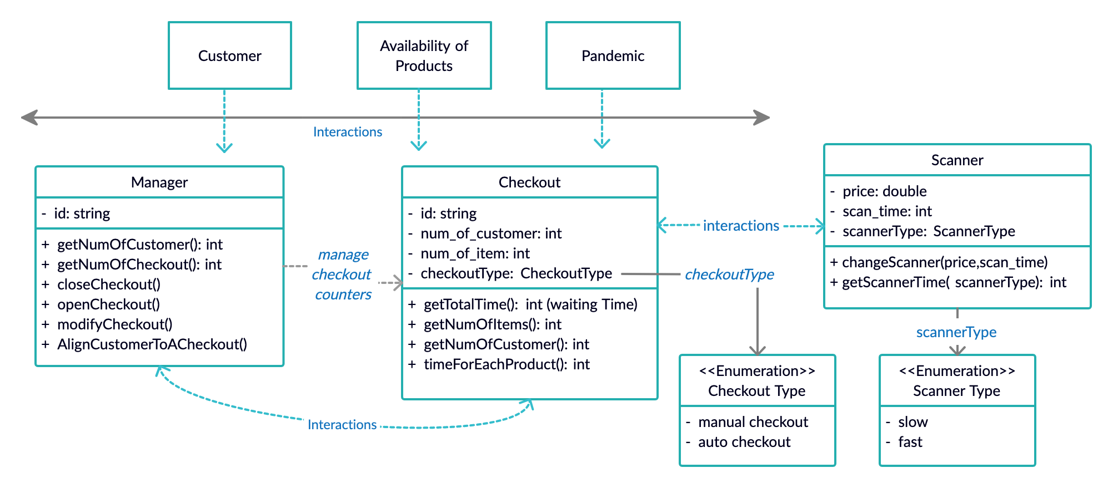
Agents
Manager
Checkout
Scanner

Slide 5
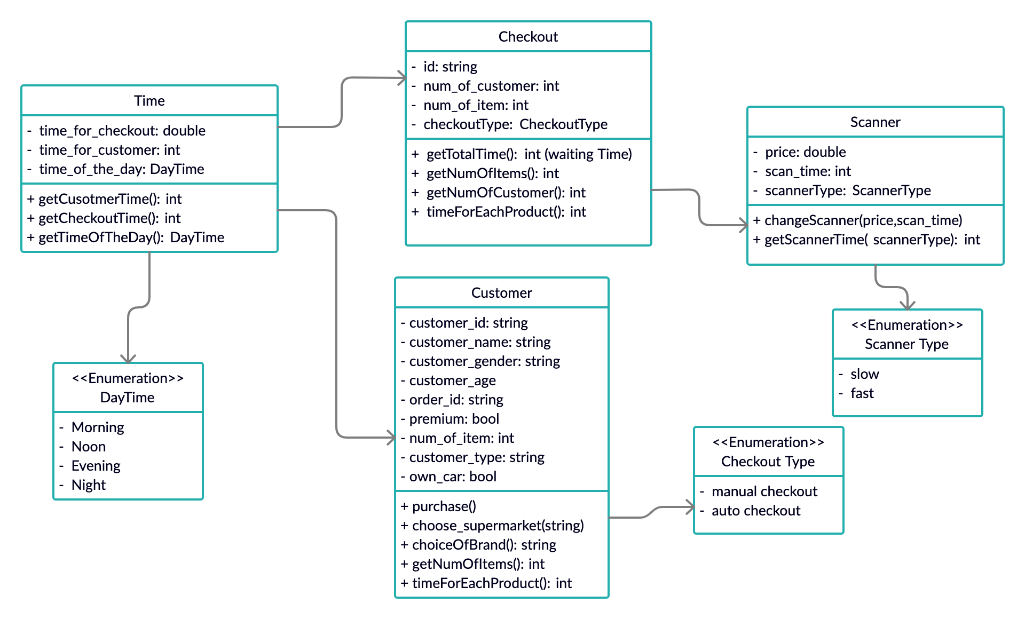
Time Agent

